Slide 1



MITRE Attack Flow:
Laying the Foundation for
Predictive Intelligence
Jon Baker
Prashant
Cyber Security Advisor in Oil &Gas
https://www.linkedin.com/in/prashantprofile/
Twitter: @prashant_geek
GitHub: https://github.com/prashant-iiitm
Co-Founder & Director
Center for Threat-Informed Defense
Disclaimer: Views, thoughts, and opinions expressed in the talk belong solely to the author(s), and not necessarily to the author's employer, organization or any committee.

Slide 2

What is
Threat-
The systematic application of a
deep understanding of
Informed
adversary tradecraft and
technology to improve defenses.
Defense?

Slide 3

Threat-Informed Defense Cycle
Consume
Cyber Threat
Intel on
adversaries &
TTPs
Emulate TTPs
to validate
defenses
Evaluate
defenses
against TTPs
Implement
TTP
prevention /
detection

Slide 4
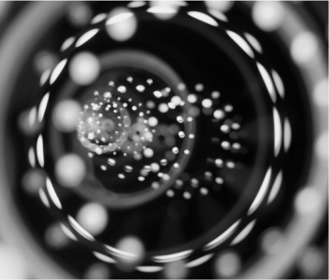



Threat-Informed Defense is…
a lens, through
a way to think
a way to prioritize
a way of assessing
which, you can
about your security
your security
the effectiveness
understand your
architecture and
strategy and
of security of your
security posture
operations
investments
investments

Slide 5
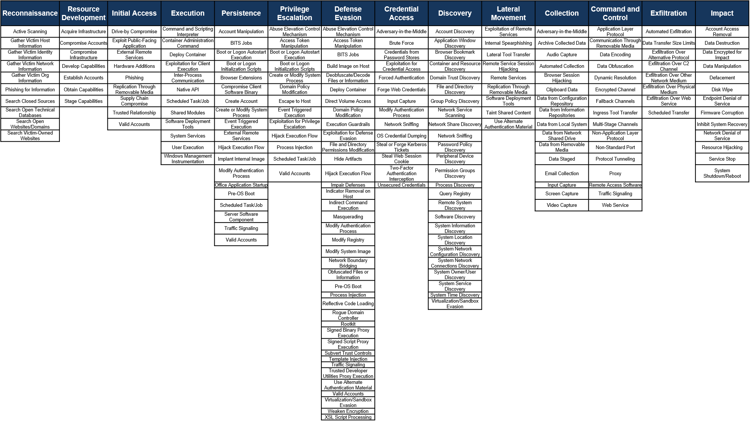
MITRE
A community-driven
knowledgebase of
adversary TTPs

Slide 6
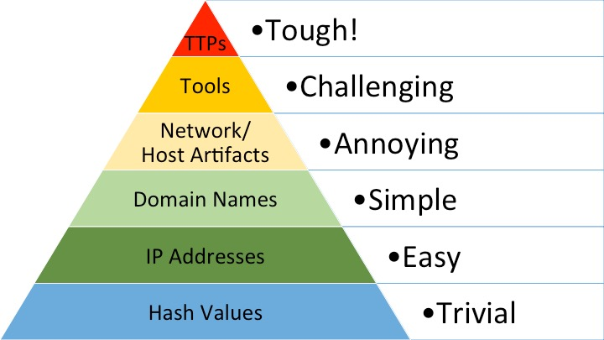
+
* Pyramid of Pain by David Bianco http://detect-respond.blogspot.com/2013/03/the-pyramid-of-pain.html
ATT&CK and the “Pyramid of Pain”
A global shift towards increasing the cost for the adversary

Slide 7
What’s happening now?

Slide 8



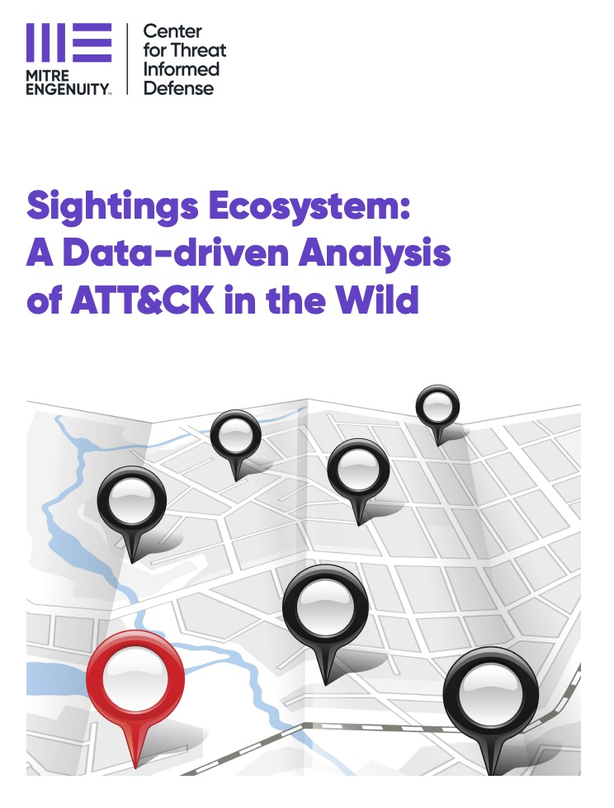



Problem
Sightings Ecosystem
Defenders lack visibility into which
adversary behaviors they should focus
their attention on first.
Solution
Built an ecosystem for organizations to
safely contribute sightings of specific
ATT&CK TTPs, powering analytics that
give defenders a picture of what TTPs
are used where and when.
Impact
The sightings ecosystem injects real-
world data and insights from that data
into the decision-making process of
defenders, allowing them to focus their
resources on the highest-priority
problems.
https://mitre-engenuity.org/blog/2022/02/23/sightings-ecosystem/

Slide 9
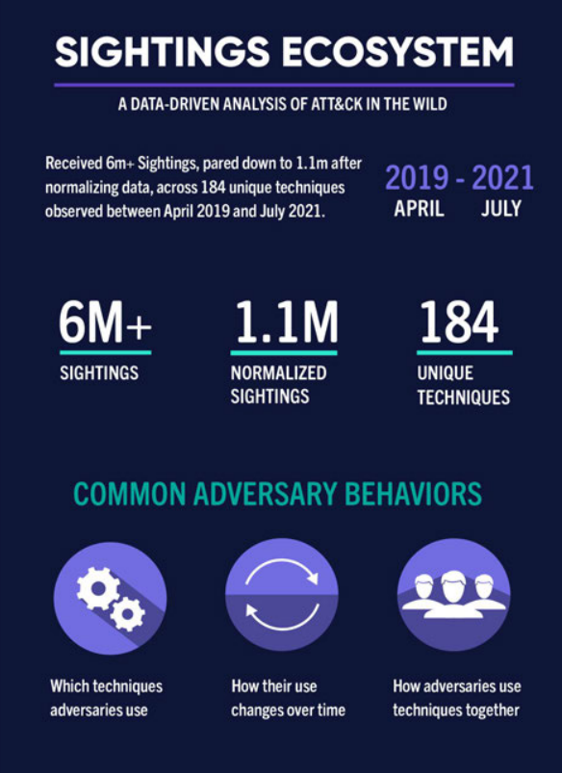
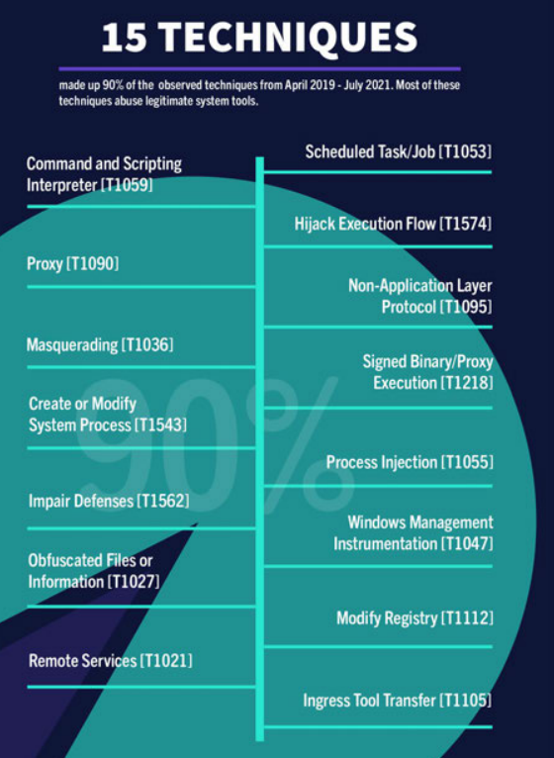
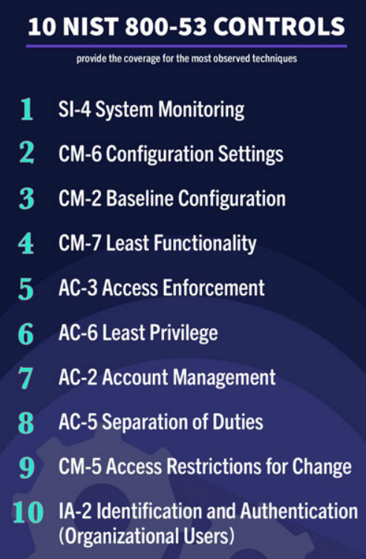
GitHub for Sightings Ecosystem Project

Slide 10
Where do I start?

Slide 11
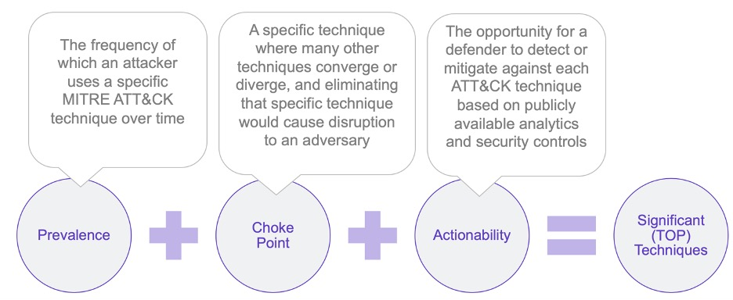
Problem
Top ATT&CK Techniques
Defending against all ATT&CK
techniques is simply not practical and,
without guidance, determining which
techniques to focus on is overwhelming.
Solution
Publish a methodology and tools to help
defenders systematically prioritize
ATT&C K techniques.
Impact
Defenders focus on the adversary
behaviors that are most relevant to
their organization and have the greatest
effect on their security posture.

Slide 12

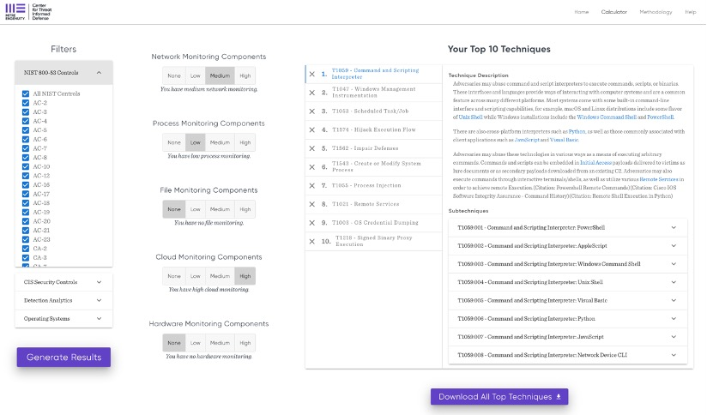
Problem
Top ATT&CK Techniques
Defending against all ATT&CK
techniques is simply not practical and,
without guidance, determining which
techniques to focus on is overwhelming.
Solution
Publish a methodology and tools to help
defenders systematically prioritize
ATT&CK techniques.
Impact
Defenders focus on the adversary
behaviors that are most relevant to
their organization and have the greatest
effect on their security posture.
https://top-attack-techniques.mitre-engenuity.org/

Slide 13
What about the latest attack?

Slide 14
Describing Adversary Behavior
Atomic Behaviors
Sequenced Behaviors
Ingress
Tool
Transfer
Ingress
Tool
Transfer
Power-shell
Power-
shell
Obfuscated Files
Obfuscated Files
LSASS
Memory
LSASS
Memory

Slide 15
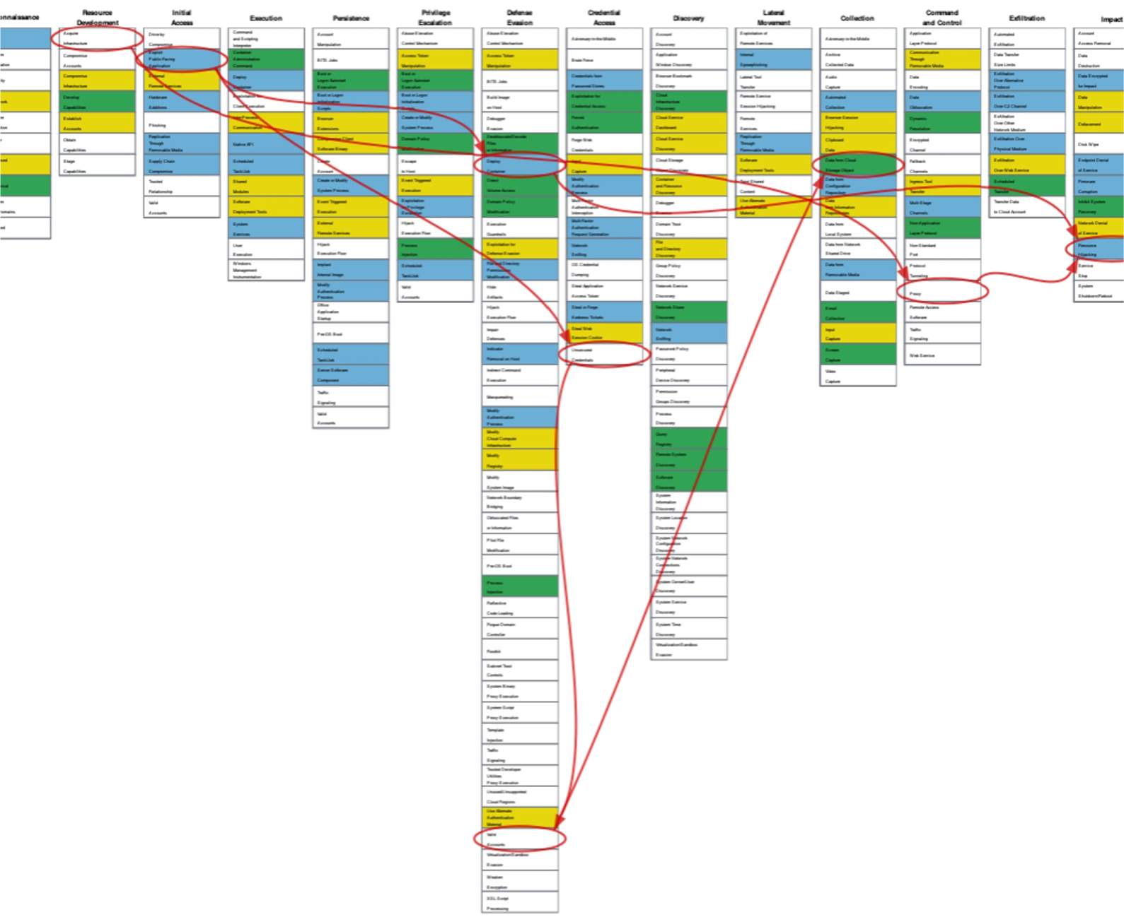
Problem
Attack Flow
Defenders often track adversary
behaviors atomically, focusing on one
specific action at a time. This makes it
harder to understand adversary attacks
and to build effective defenses against
those attacks.
Solution
Create a language, and associated
tooling, to describe flows of ATT&CK
techniques and combine those flows
into patterns of behavior.
Impact
Help defenders and leaders understand
how adversaries operate and compose
atomic techniques into attacks to better
understand defensive posture.

Slide 16
Problem
Attack Flow
Defenders often track adversary
behaviors atomically, focusing on one
specific action at a time. This makes it
harder to understand adversary attacks
and to build effective defenses against
those attacks.
A data model with supporting tools and examples for
describing sequences of adversary behaviors.
Solution
Create a language, and associated
tooling, to describe flows of ATT&CK
techniques and combine those flows
into patterns of behavior.
Impact
Understand, share, and make threat-informed decisions
based on the sequence of actions in a cyber-attack.
Help defenders and leaders understand
how adversaries operate and compose
atomic techniques into attacks to better
understand defensive posture.
•
•
•
identify common patterns in adversary behavior
overlay on ATT&CK to understand defensive coverage
create intel-driven adversary emulation plans

Slide 17
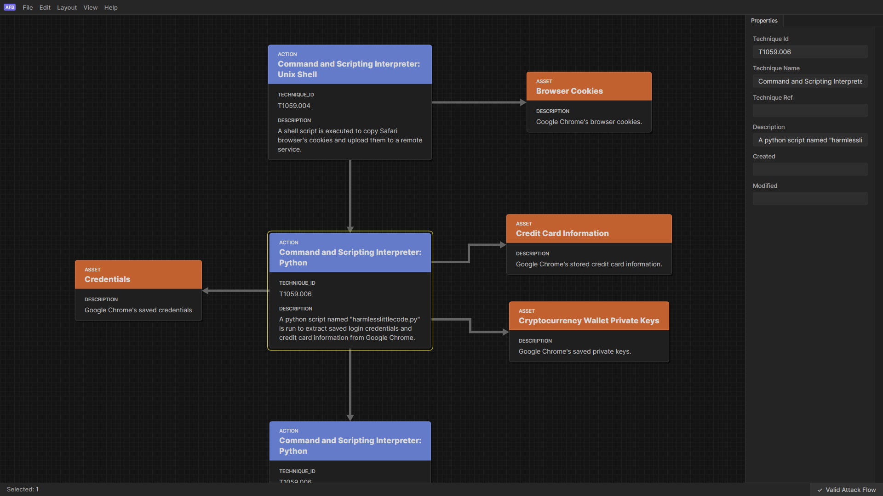


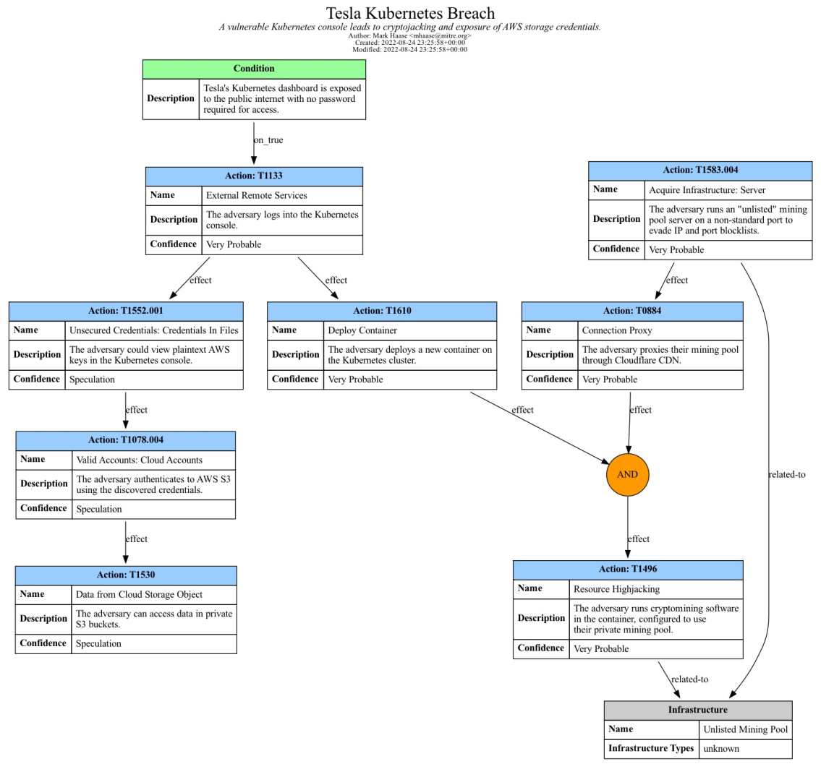
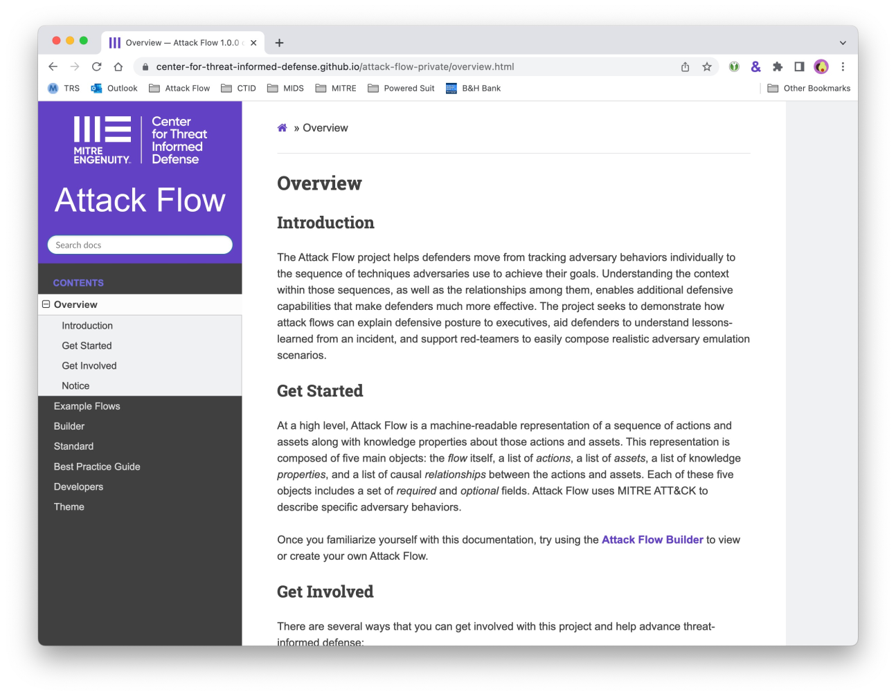
Get started with Attack Flow
https://center-for-threat-informed-defense.github.io/attack-flow/
16

Slide 18
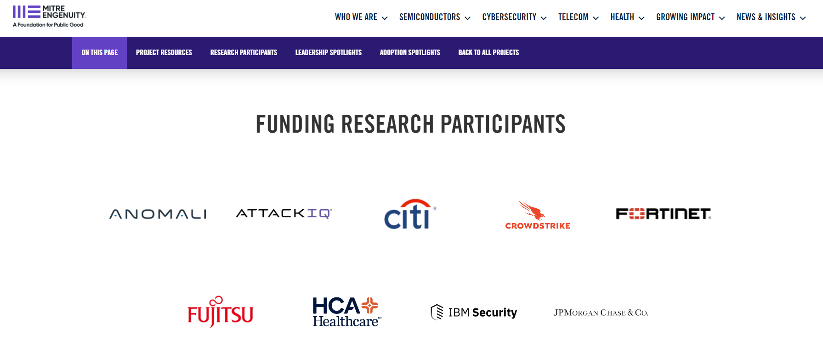

Slide 19
What can we learn from the past?

Slide 20


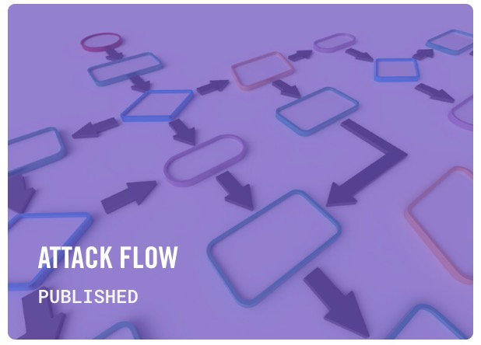
Predictive intelligence
What have adversaries been doing?
How are adversaries changing?
Capture, share, and analyze
patterns of attack
What is the next most likely
thing they will do?
As a community, we can build upon this foundation to enable predictive intelligence...
What should I look for next?
What likely proceeded this?
Who is attacking?
What is their motive?
How can I detect this attack?

Slide 21
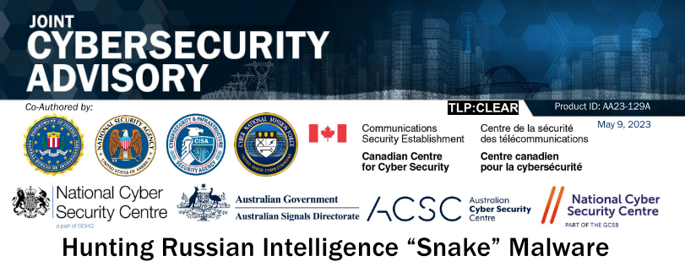
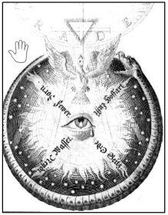
CASE STUDY: SNAKE MALWARE WITH MITRE ATT&CK FRAMEWORK
Russian FSB (Federal Security Service) began developing Snake as “Uroburos” in 2003
Snake implant is the most sophisticated cyber espionage tool developed by FSB
Covert P2P network created by Snake to do cyber espionage
Custom Communications Protocol employ encryption and fragmentation for confidentiality
FSB actors use Snake to access and exfiltrate sensitive international documents from their targets

Slide 22
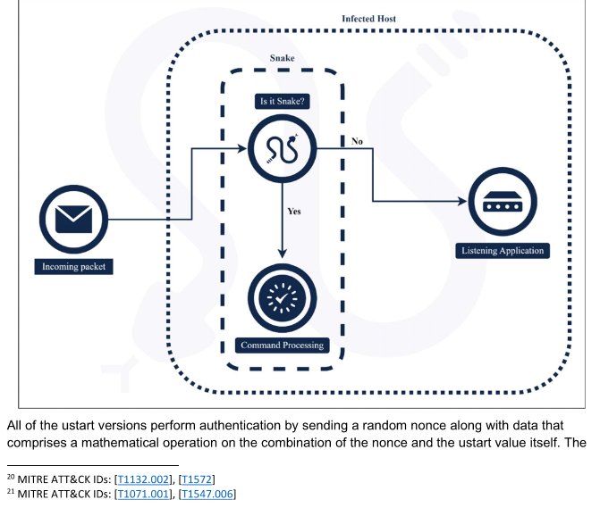
Snake Network Sessions Distinction

Slide 23
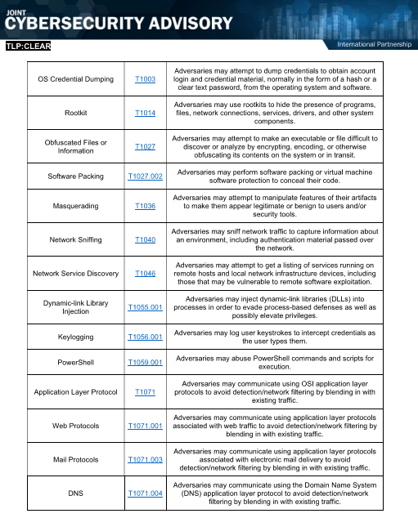
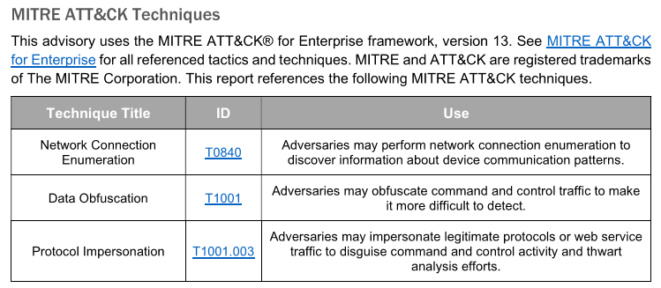

Slide 24
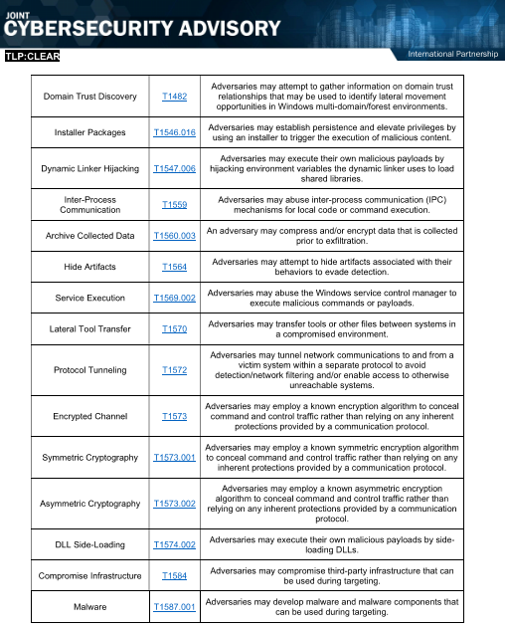
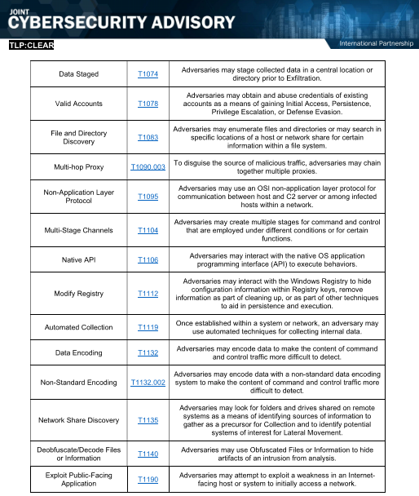

Slide 25
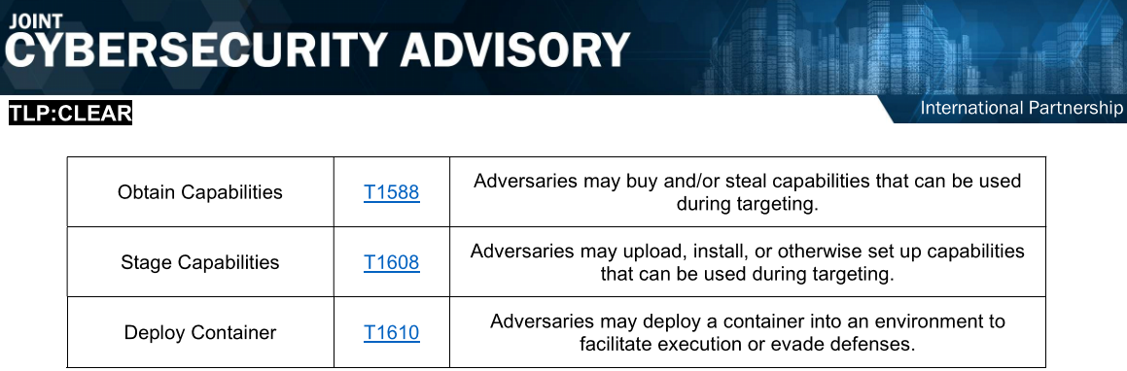

Slide 26
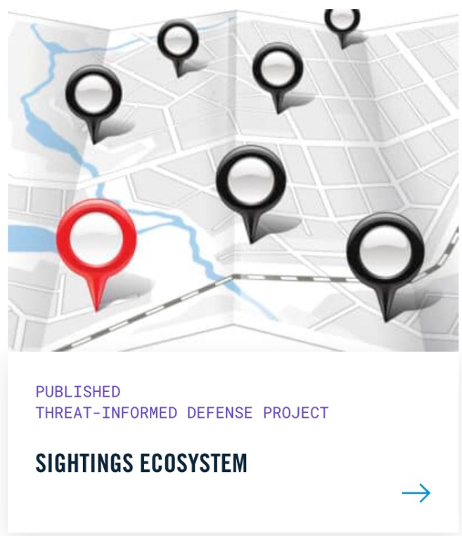
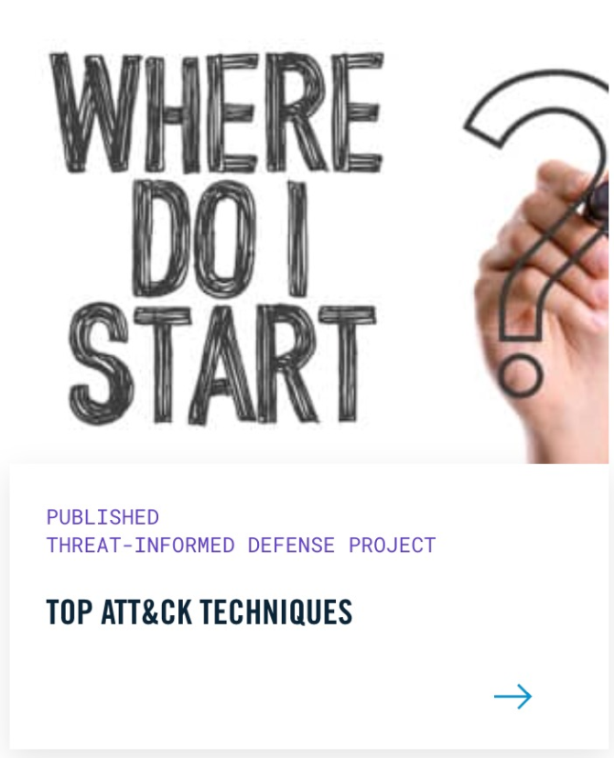
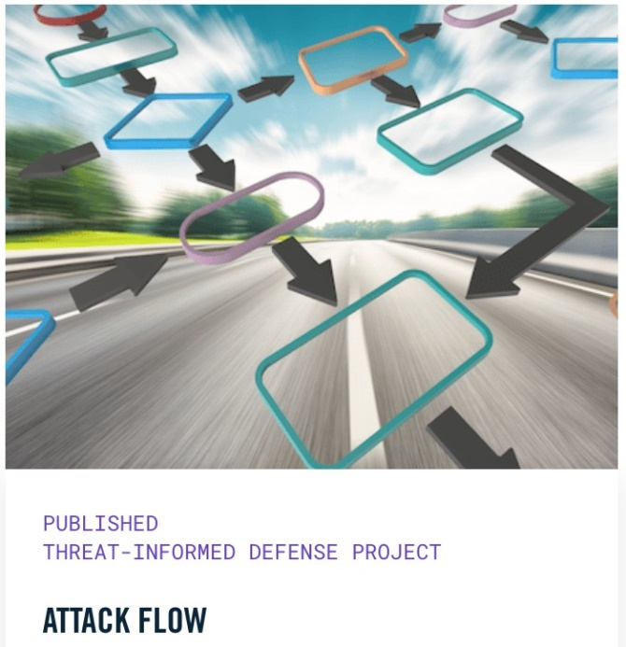
Advance threat-informed defense with us
Spread the word to help MITRE increase the impact of the work.
Share your ideas and they may become part of the R&D program.
Use our work and tell us about it.
Advance the research program by joining us.
Check out the Impact Report
Follow our R&D
https://ctid.mitre-engenuity.org/impact-report/
https://
ctid.mitre-engenuity.org/our-work/

Slide 27
Thank you for your attention
jbaker@mitre-engenuity.org
prashant_iiitmg@yahoo.com
https://mitre-engenuity.org/cybersecurity/center-for-threat-informed-defense/

